Slide 1



Batch Name: MIP-DA-07 project on Corona Virus Analysis
Sonia Dogra

Slide 2
agenda
Overview
Dataset
Problem statement query with output
Conclusion

Slide 3

Corona Virus Analysis Project

Slide 4
The CORONA VIRUS pandemic has had a significant impact on public health and has created an urgent need for data-driven insights to understand the spread of the virus. As a data analyst, you have been tasked with analyzing a CORONA VIRUS dataset to derive meaningful insights and present your findings.

Slide 5

Description of each column in dataset:

Slide 6
Province: Geographic subdivision within a country/region. Country/Region: Geographic entity where data is recorded. Latitude: North-south position on Earth's surface. Longitude: East-west position on Earth's surface. Date: Recorded date of CORONA VIRUS data. Confirmed: Number of diagnosed CORONA VIRUS cases. Deaths: Number of CORONA VIRUS related deaths. Recovered: Number of recovered CORONA VIRUS cases.

Slide 7

Data-driven Insights
Critical Need for Data
Data-driven insights are crucial to accurately assess the spread and impact of the virus.
Real-time Analysis
Real-time data analysis aids in understanding transmission patterns and predicting trends.
Policy Decision Support
Data insights guide policymakers in implementing effective mitigation strategies.

Slide 8
Analyzing COVID-19 Dataset
Healthcare Resource Allocation
Epidemiological Trends
Risk Factor Identification
Insights help in allocating resources to areas with the highest impact and need.
Analyzing the dataset unveils geographical and demographic patterns of the virus.
Identifying high-risk groups and factors contributing to virus transmission.

Slide 9
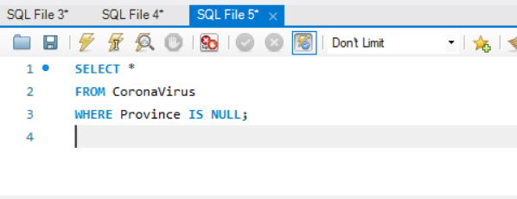
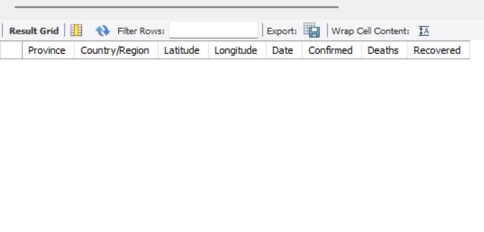
Q1. Write a code to check NULL values
output

Slide 10
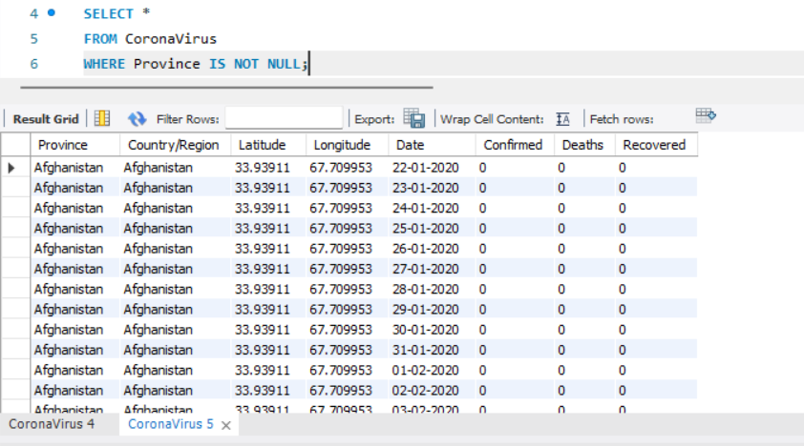
Province is not null

Slide 11
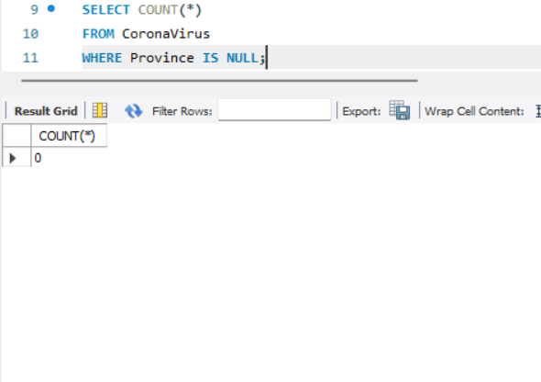
Count all and Province is null

Slide 12
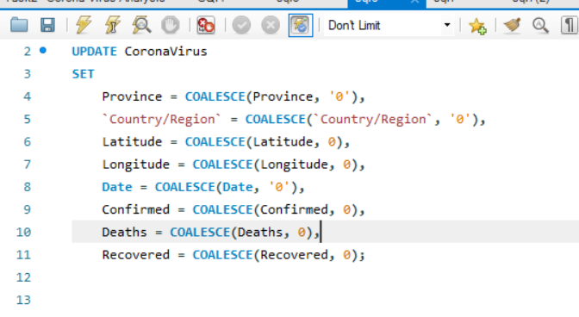
If NULL values are present, update them with zeros for all columns.
0 Row Effected

Slide 13
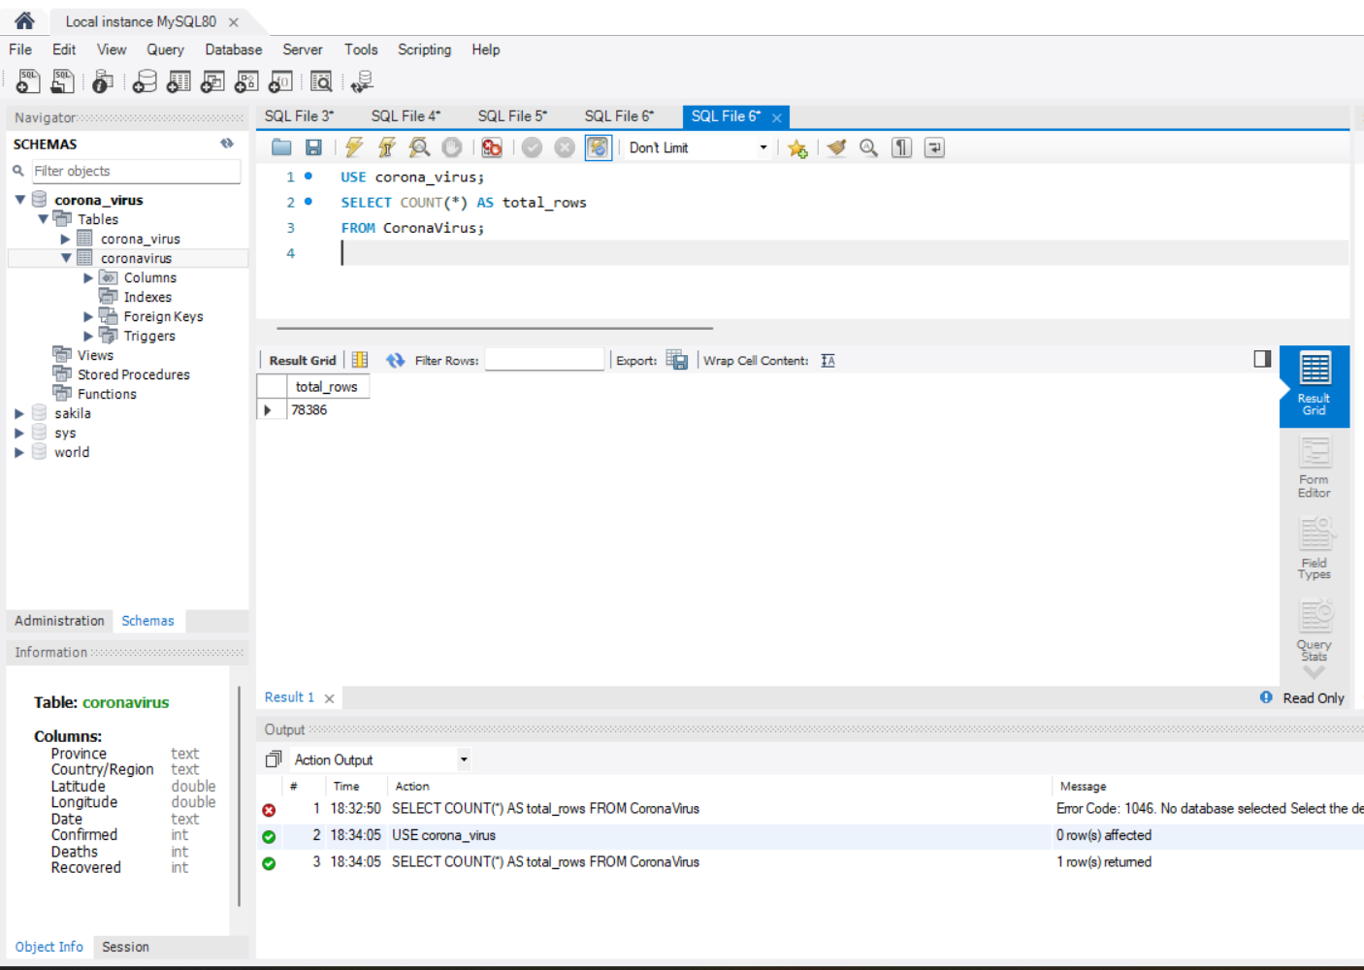
check total number of rows

Slide 14
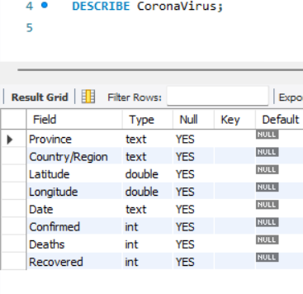
Check what is start_date and end_date

Slide 15
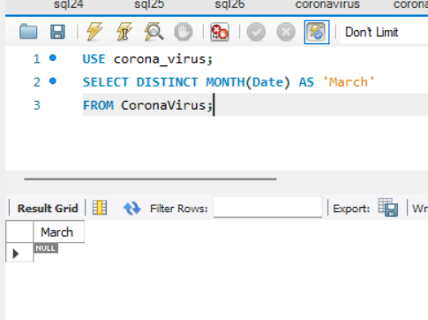
Number of month present in dataset

Slide 16
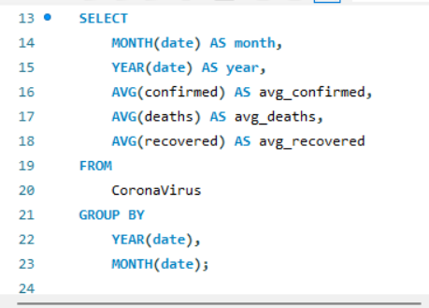
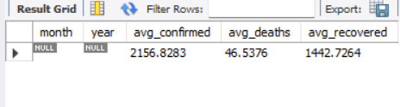
Find monthly average for confirmed, deaths, recovered

Slide 17
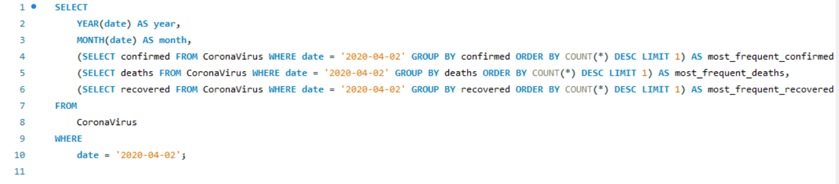
Find most frequent value for confirmed, deaths, recovered each month

Slide 18
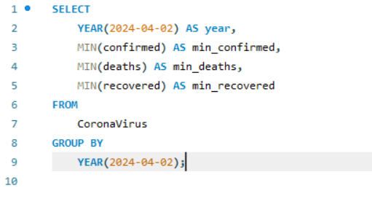
Find minimum values for confirmed, deaths, recovered per year
0 confirmed, deaths, recovered

Slide 19
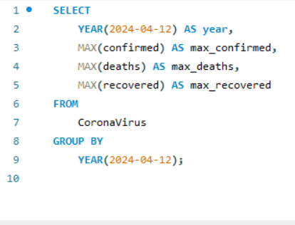
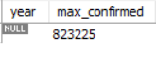
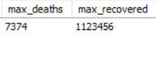
Find maximum values of confirmed, deaths, recovered per year

Slide 20
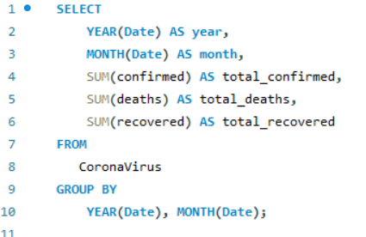
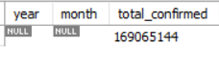
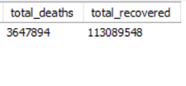
The total number of case of confirmed, deaths, recovered each month

Slide 21
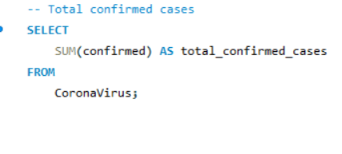
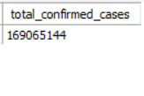
Check how corona virus spread out with respect to confirmed case
(Eg.: total confirmed cases, their average, variance & STDEV )

Slide 22
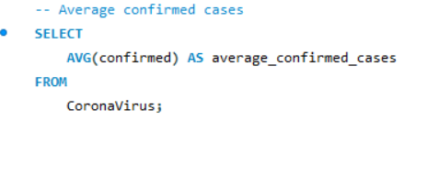
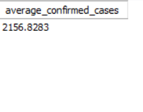

Slide 23
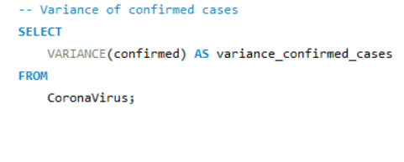
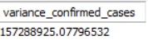

Slide 24
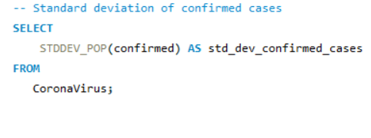
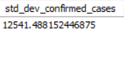

Slide 25
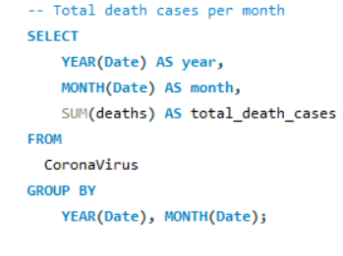
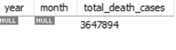
Check how corona virus spread out with respect to death case per month -- (Eg.: total confirmed cases, their average, variance & STDEV )

Slide 26
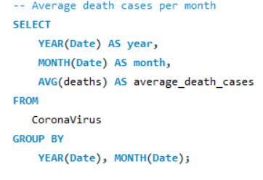
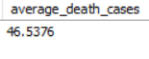

Slide 27
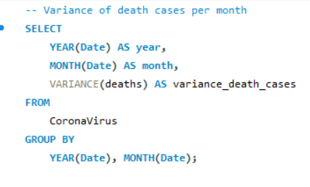
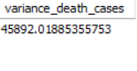

Slide 28
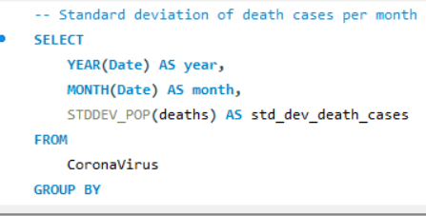
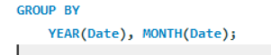
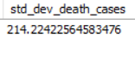

Slide 29
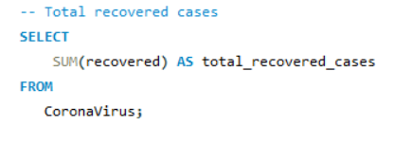
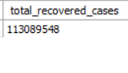
Check how corona virus spread out with respect to recovered case -- (Eg.: total confirmed cases, their average, variance & STDEV )

Slide 30
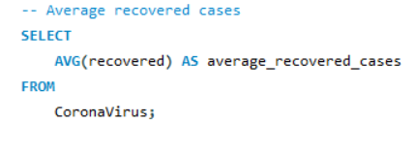
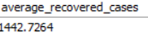

Slide 31
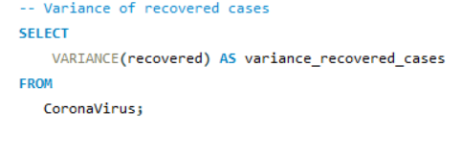
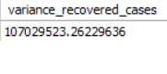

Slide 32
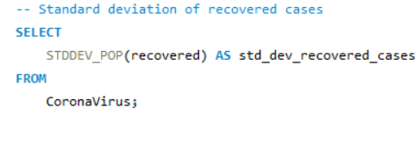
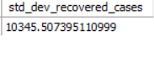

Slide 33
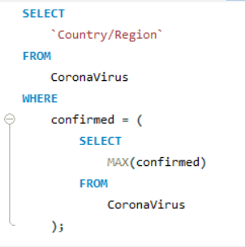
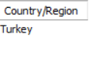
Find Country having highest number of the Confirmed case

Slide 34
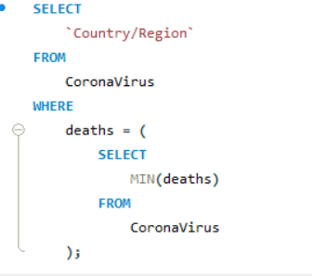
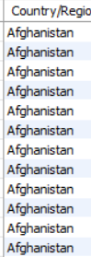
Find Country having lowest number of the death case
43082 Country/Region

Slide 35
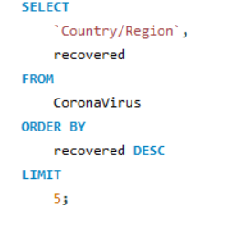
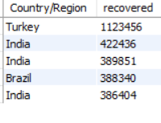
Find top 5 countries having highest recovered case

Slide 36
Conclusion
The SQL analysis of the corona dataset provides insights into the pandemic's spread, including trends over time, monthly averages, and country-specific metrics. It reveals patterns of infection, recovery, and mortality, aiding in understanding and managing the crisis efficiently.

Slide 37
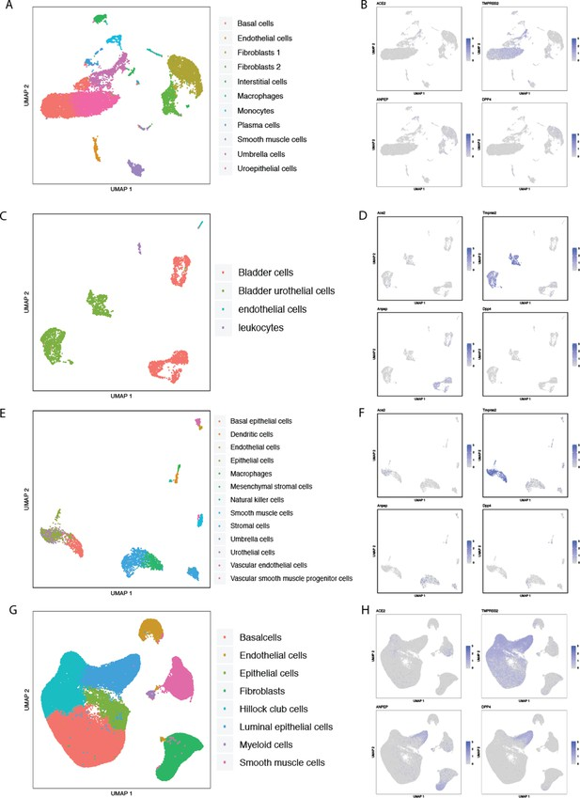
Thank you

